Slide 1
Melbourne
Real Estate
Presentation

Slide 2
Meet Our Team
GROUP 5
Anton
Karunadhipathi Abeyakoon
Malini Sintre
Masih Qadir

Slide 3
Dataset
Interest Rate
https://www.rba.gov.au/statistics/tables/#interest-rates
Statistical tables for a range of economic and financial data produced by the Reserve Bank of Australia and other organisations.
Melbourne Housing Dataset
https://www.kaggle.com/datasets/ronikmalhotra/melbourne-housing-dataset?resource=download
This housing dataset provides a thorough analysis for 2016 to 1st Quarter 2018 of the housing market.
It includes information on housing prices, availability, and key trends, allowing you to gain a better understanding of the market and make informed decisions. Whether you're a homebuyer, investor, or simply interested in the state of the housing market, this dataset has valuable insights to offer.

Slide 4
How does the changes of interest rate impact the housing market?
Which is the optimal Location for Real Estate Investment?
Most expensive Melbourne suburbs and factors affecting the prices in these suburbs?

Slide 5
Let’s talk about the 1st question
1. How does the changes of interest rate impact the housing marke?

Slide 6
Real Estate Market (Melbourne) & Interest Rate
Interest Rate
Period 2016 – 2017 analysis
Number of Houses Sold
Sales count vs Housing Interest rate each month
Houses Sold
Housing Price vs Interest Rate each month

Slide 7
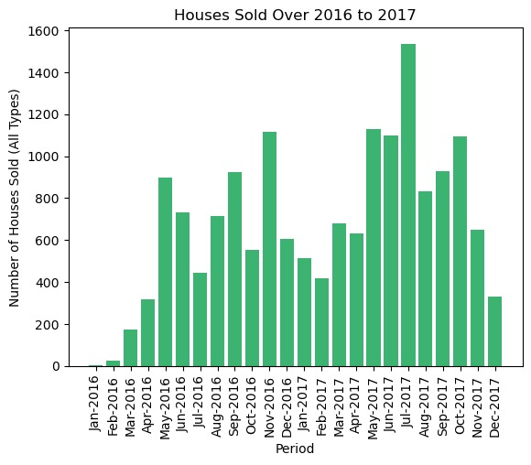
Houses Sold
Time period: 24 months from 2016 to 2017
Objective: Represents the number of houses sold
Observation: More houses were sold in 2017 compared to the same period in 2016
Assumption: Assumes no external factors changed from 2016 to 2017.
Hypothesis: Suggests that 2016 might have had higher interest rates compared to 2017.
Note: Further analysis is needed to confirm the hypothesis and explore other potential factors influencing the difference in house sales between the two years

Slide 8
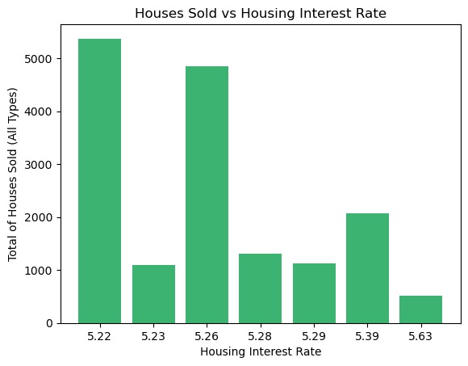
Houses Sold vs Interest Rates
Variables: Houses sold vs Interest rate when sold
Observation: Majority of houses sold when interest rates were 5.26% and below.
Deduction: Suggests that lower interest rates positively affect the number of houses sold.
Note: Analysis based solely on the barplot; more in-depth analysis is required.
Further Analysis: Additional investigation needed to explore other potential factors influencing house sales and to establish a more comprehensive understanding of the relationship between interest rates and houses sold.

Slide 9
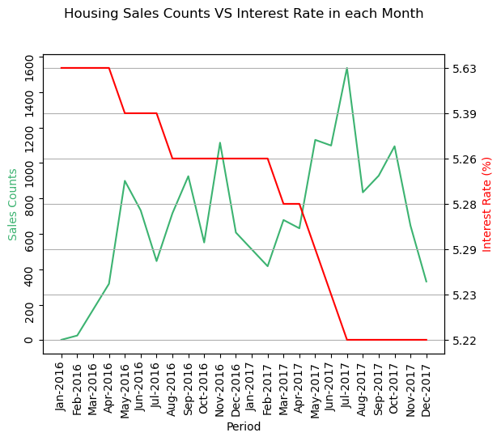
Housing counts vs Interest rate in 2 years
Some statistics
Interest rate
Mean: 5.33%
Max : 5.63
Min : 5.22
Sale counts
Mean: 681
Max : 1536
Min : 2
Trends
Interest rate
Decreasing over the 2 years.
From 5.63 to 5.22.
Sale counts
Slow increase over the 2 years.
Fluctuating between 681 and 1536.

Slide 10
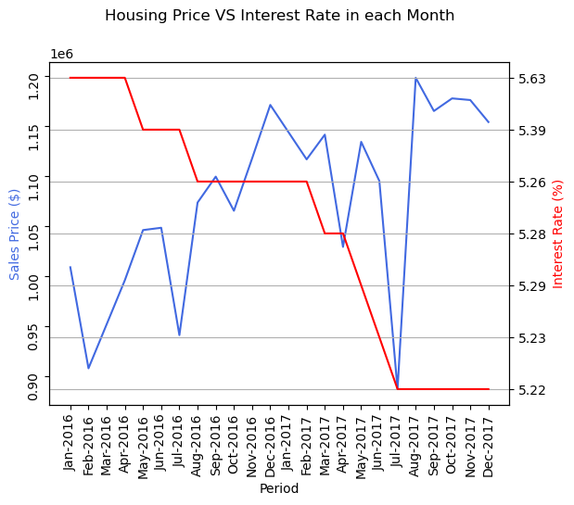
Housing price vs Interest rate in 2 years
Some statistics
Interest rate
Mean: 5.33%
Max : 5.63
Min : 5.22
Sale prices
Mean: 1.08M
Max : 1.20M
Min : 0.89M
Trends
Interest rate
Decreasing over the 2 years.
From 5.63 to 5.22.
Sale prices
Increasing over the 2 years.
Fluctuating between 0.89M and 1.20M.

Slide 11
Let’s talk about the 2nd question
2. Which is the optimal Location for Real Estate Investment?

Slide 12
Question 2-Optimal Location for Real Estate Investment:
Analysis of Melbourne Real Estate Investment Potential
The goal of this analysis is to determine the best and worst suburbs in Melbourne for real estate investment based on a scoring system. This system evaluates properties based on various factors such as distance from the city centre, property features, and suburb density.

Slide 13
Analysis – Introduction
Data Preparation:
The dataset contains several attributes of properties in Melbourne, which include: - Suburb location - Distance from the city center - Number of rooms, bedrooms, and bathrooms - Availability of car spaces - Land and building area - Age of the building - Density of properties in the suburb `inf` values, which are placeholders for infinity, are replaced with `Nan` to allow for numerical operations.
Normalization:
To compare these attributes on an equal footing, we normalize them to a scale of 0 to 1. This is done by subtracting the minimum value from each value in the column and then dividing by the range of the column.

Slide 14
Analysis –Developing a scoring system
Scoring Function:
A scoring function is defined to apply the weights to each normalized feature. The weights are as follows: - `Distance`: -1 (closer to city center is better) - `Rooms`: 1 - `Bedroom`: 1 - `Bathroom`: 1 - `Car`: 1 - `Land size`: 1 - `Building Area`: 1 - `Building Age`: -0.5 (newer buildings might be preferred) - `Property count`: 1 (less density is presumed to be better)
Calculating Scores:
Each property is scored by multiplying its features by their respective weights and summing the results. These scores represent the investment potential of the property, with higher scores indicating a more attractive investment.

Slide 15
Analysis – Developing a scoring system
In order to validate data and address the inconsistencies caused by many outliers which affects the data pattern and final conclusion “ Remove Outliers function “ Included
Remove outliers function applied to following columns
Price', 'Landsize', 'BuildingArea

Slide 16
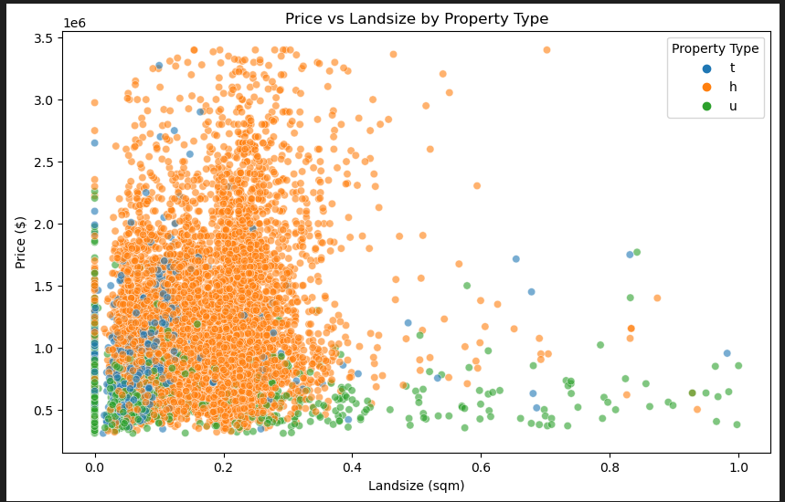
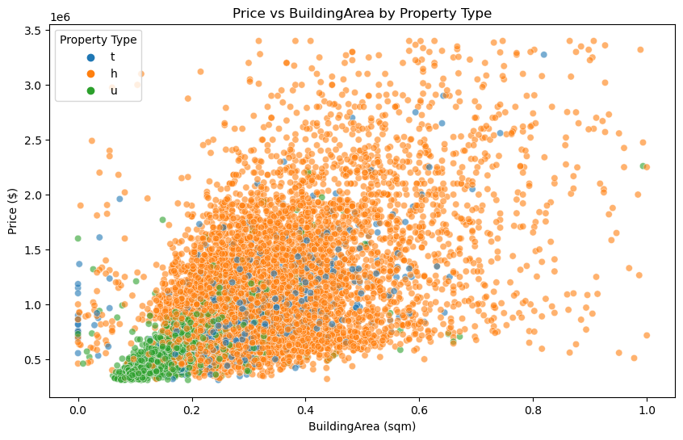
Graph 1 and 2

Slide 17
Graph 1 and 2 Explanation
The correlation function to identify the strength and direct relationships between variables
Explanation Graph 1: This plot shows the relationship between property prices and land size, differentiated by property type.
Inference: Larger land sizes usually command higher prices, with variations across different property types.
For example houses in remote areas will be higher in land value and lower in Price.
Explanation Graph 2: This visualization depicts the correlation between property prices and building area, distinguished by property type.
Inference: Generally, larger building areas are associated with higher property prices, though this varies by type.
Interpretation
Correlation between Price and Land size 0.2171432770316884
Correlation between Price and BuildingArea 0.5578617577181919

Slide 18
Graph 1 and 2 Explanation
Interpretation
Correlation between Price and Landside 0.2171432770316884
Correlation between Price and BuildingArea 0.5578617577181919
There is a moderate positive correlation between Price and Building area (Higher the Building area higher the Price) In comparison to Price and Building area correlation of 0.21 The building area to price relationship appears to be moderately strong .
When determining optimal investment It is important not to only rely on Correlation But also consider Causation which identify the cause and effect.

Slide 19
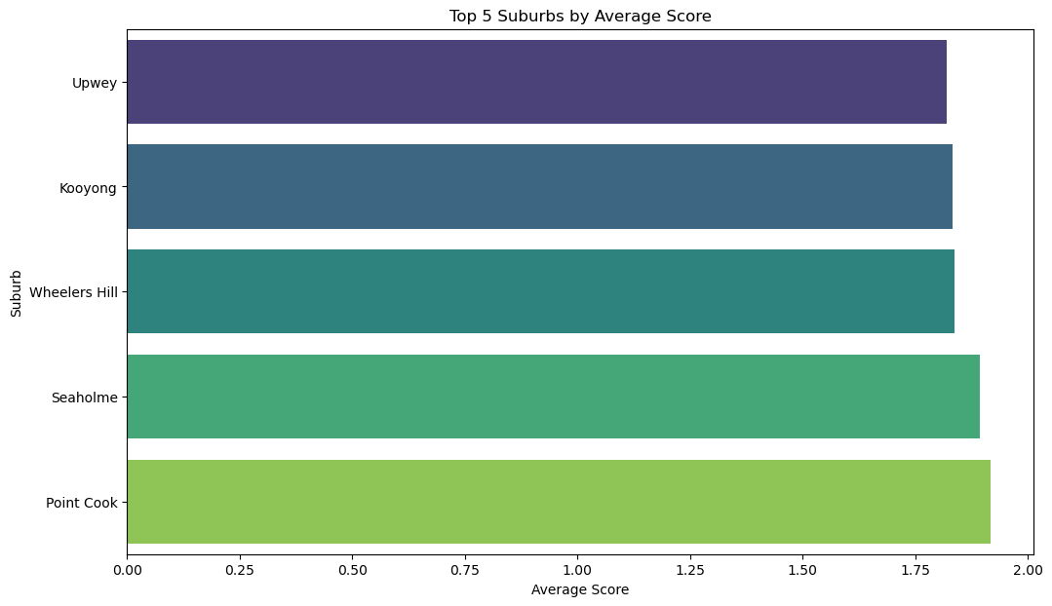
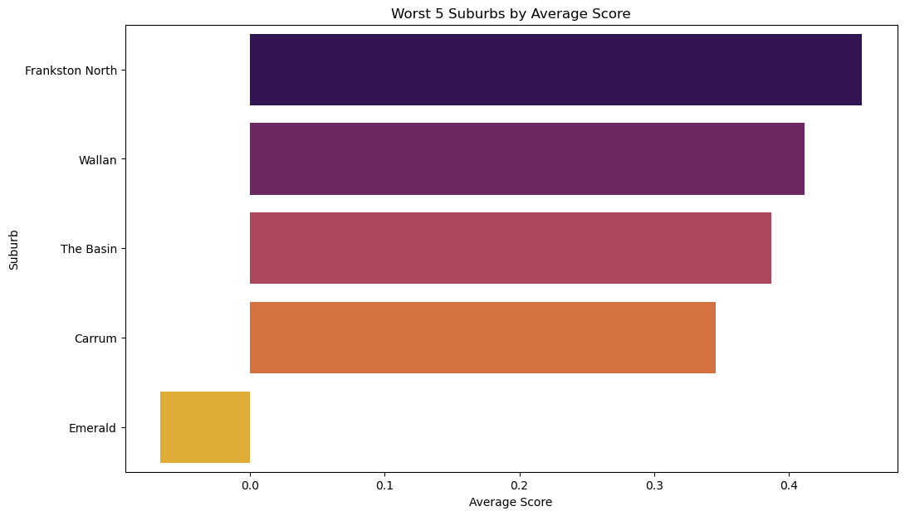
Graph 3 and 4

Slide 20
Graph 3 and 4 Explanation
Explanation Graph 3: Explanation: This bar graph ranks the top 5 suburbs in Melbourne based on a composite score from various property features.
Inference: Suburbs like Seaholme rank highest, indicating favourable property features. (Based on Higher average score)
Explanation Graph 4
This graph shows the suburbs with the lowest scores, reflecting less favorable property characteristics.
Inference: Suburbs such as Emerald and Carrum have lower scores, suggesting less desirable aspects.
(Based on Lower average score)

Slide 21
Conclusion for question 2
The average score is grouped by suburb based on factors such as ‘Price,Distance', 'Rooms', 'Bedroom', 'Bathroom', 'Car', 'Land size.
Based on average score ( adjusted for outliers ) Seaholme Ranks 1st in relation to Optimal location for real estate investment.
The suburbs are ranked based on their average scores, and the top 5 suburbs with the highest scores are identified as the best for investment. Conversely, the suburbs with the lowest scores are identified as the worst for investment.
The analysis provides a data-driven approach to identify attractive and unattractive suburbs for real estate investment in Melbourne. This methodological approach can be enhanced further by integrating more direct measures such as crime rates, school ratings, and amenities when such data becomes available.

Slide 22
Limitations of the Melbourne Housing Dataset
Incomplete Features
One significant limitation is the dataset's incomplete features. Key attributes that influence property values, such as the quality of finishes, state of repair, or architectural style, are not included. This exclusion means the dataset may not fully capture the nuances that can significantly impact a property's market value.
Geographic Specificity
While the dataset provides detailed information within Melbourne, it lacks broader geographic coverage. This limitation restricts the dataset's applicability for comparative analysis with other regions or for understanding broader market trends that might impact Melbourne indirectly.

Slide 23
Let’s talk about the 3rd question
3. Most expensive Melbourne suburbs and factors affecting the prices in these suburbs?

Slide 24
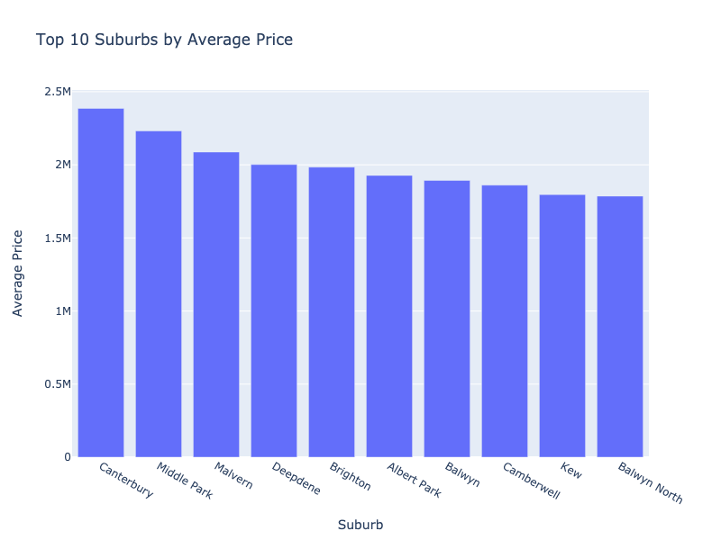
Most expensive suburbs in Melbourne & Factors affecting the prices
The graph shows the top 10 suburbs based on their average housing prices. The x-axis represents the suburbs, while the y-axis represents the average price.
The graph is a bar plot, where each bar represents a suburb and its corresponding average price. The height of each bar indicates the average price of the suburb.

Slide 25
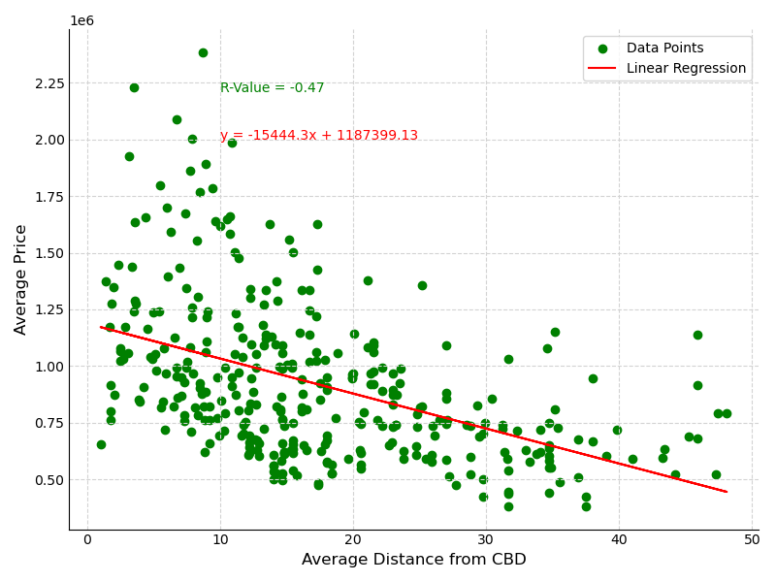
"Analysing the Relationship between Average Distance from CBD and Average Housing Prices"
1. The code is performing a linear regression analysis between 'Average Distance from CBD' and 'Average Price'. This is to understand the relationship between these two variables.
2. The slope and intercept obtained from the linear regression can give us an idea about the nature of the relationship. The slope is negative, it means that as the average distance from CBD increases, the average price decreases.
3. The R-value (or correlation coefficient) indicates the strength and direction of the relationship between the two variables. A value close to 1 indicates a strong positive relationship, a value close to -1 indicates a strong negative relationship, and a value close to 0 indicates no relationship. In this case the r value is -0.47, which means there is a negative correlation between the average distance from CBD and the average price of housing. When the average distance from CBD increases, the average price of housing decreases and vis-Versa.
4. The scatter plot visualizes the data points and the linear regression line, which can help us visually understand the relationship between the two variables.

Slide 26
THANK YOU

